Slide 1
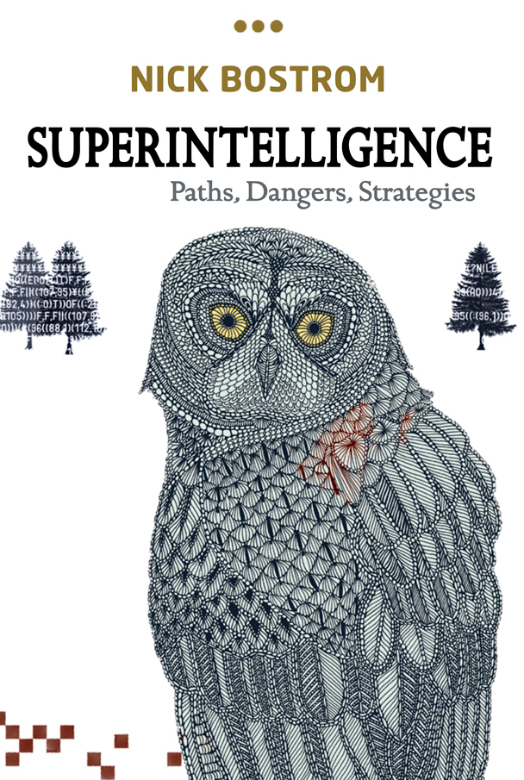
Crucial Considerations and Wise Philanthropy
Professor Nick Bostrom
Director, Future of Humanity Institute
Oxford Martin School
Oxford University

Slide 2
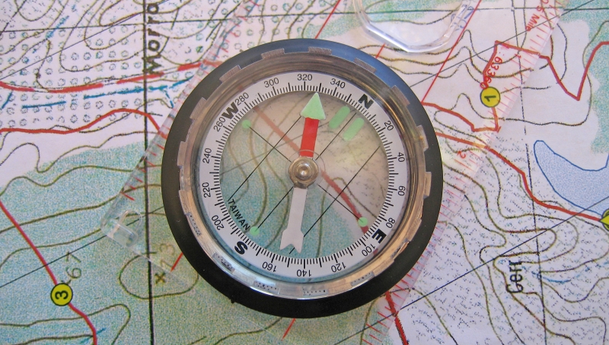
What is a crucial consideration?
Notes:
We are placing this explication in a broadly consequentialist framework, at some loss of generality. When this becomes a problem, one could revert to one of the earlier formulations.

Slide 3
What is a crucial consideration?
  a consideration such that if it were taken into account it would overturn the conclusions we would otherwise reach about how we should direct our efforts
  an idea or argument that might plausibly reveal the need for not just some minor course adjustment in our practical endeavors but a major change of direction or priority
Notes:
We are placing this explication in a broadly consequentialist framework, at some loss of generality. When this becomes a problem, one could revert to one of the earlier formulations.

Slide 4
What is a crucial consideration?
  a consideration such that if it were taken into account it would overturn the conclusions we would otherwise reach about how we should direct our efforts
  an idea or argument that might plausibly reveal the need for not just some minor course adjustment in our practical endeavors but a major change of direction or priority
  A crucial consideration (CC) is a consideration that radically changes the expected value of pursuing some high-level subgoal.
Notes:
We are placing this explication in a broadly consequentialist framework, at some loss of generality. When this becomes a problem, one could revert to one of the earlier formulations.

Slide 5
Related concepts
Crucial consideration components
  Considerations (arguments, ideas, data) which, while not on their own amounting to CCs, have a substantial probability of serving a central role within a CC
Deliberation ladders
  Sequence of CCs

Slide 6
Should I vote in the national election?

Slide 7
Should I vote in the national election?
(A1) I should vote in order to put the better candidate into office.

Slide 8
Should I vote in the national election?
(A1) I should vote in order to put the better candidate into office.
(A2) My vote is extremely unlikely to make a difference. I should not vote but put my time to better use.

Slide 9
Should I vote in the national election?
(A1) I should vote in order to put the better candidate into office.
(A2) My vote is extremely unlikely to make a difference. I should not vote but put my time to better use.
(A3) Although it is unlikely that my vote would make a difference, the stakes are very high: millions of lives are affected by the president. So even if the chance of my vote being decisive is only one in several millions, the expected benefit is large enough to be worth a trip to the polling station.

Slide 10
Should I vote in the national election?
(A1) I should vote in order to put the better candidate into office.
(A2) My vote is extremely unlikely to make a difference. I should not vote but put my time to better use.
(A3) Although it is unlikely that my vote would make a difference, the stakes are very high: millions of lives are affected by the president. So even if the chance of my vote being decisive is only one in several millions, the expected benefit is large enough to be worth a trip to the polling station.
(A4) If the election is not close, my vote will make no difference. If the election is close, approximately half the votes will be for the wrong candidate—implying that either the candidates are of almost exactly equal merit (and it scarcely matters who wins) or a typical voter’s judgment of the candidates’ merit is extremely unreliable and carries almost no signal. I should not bother to vote.

Slide 11
Should I vote in the national election?
(A1) I should vote in order to put the better candidate into office.
(A2) My vote is extremely unlikely to make a difference. I should not vote but put my time to better use.
(A3) Although it is unlikely that my vote would make a difference, the stakes are very high: millions of lives are affected by the president. So even if the chance of my vote being decisive is only one in several millions, the expected benefit is large enough to be worth a trip to the polling station.
(A4) If the election is not close, my vote will make no difference. If the election is close, approximately half the votes will be for the wrong candidate—implying that either the candidates are of almost exactly equal merit (and it scarcely matters who wins) or a typical voter’s judgment of the candidates’ merit is extremely unreliable and carries almost no signal. I should not bother to vote.
(A5) I am a much better judge of the candidates’ merits than is the typical voter. I should vote.

Slide 12
Should I vote in the national election?
(A1) I should vote in order to put the better candidate into office.
(A2) My vote is extremely unlikely to make a difference. I should not vote but put my time to better use.
(A3) Although it is unlikely that my vote would make a difference, the stakes are very high: millions of lives are affected by the president. So even if the chance of my vote being decisive is only one in several millions, the expected benefit is large enough to be worth a trip to the polling station.
(A4) If the election is not close, my vote will make no difference. If the election is close, approximately half the votes will be for the wrong candidate—implying that either the candidates are of almost exactly equal merit (and it scarcely matters who wins) or a typical voter’s judgment of the candidates’ merit is extremely unreliable and carries almost no signal. I should not bother to vote.
(A5) I am a much better judge of the candidates’ merits than is the typical voter. I should vote.
(A6) Psychological studies show that people tend to be overconfident: almost everybody believes themselves to be above average, but they are as likely to be wrong as right about that. If I’m as likely to vote for the wrong candidate as is the typical voter, then my vote would add negligible information to the selection process. I should not vote.

Slide 13
Should I vote in the national election? (cont…)
(A7) The fact that I have gone through the previous six steps demonstrates that I am exceptionally savvy. I’m therefore more likely to pick the best candidate. I should vote.

Slide 14
Should I vote in the national election? (cont…)
(A7) The fact that I have gone through the previous six steps demonstrates that I am exceptionally savvy. I’m therefore more likely to pick the best candidate. I should vote.
(A8) If I’m really so special, then the opportunity cost of my going to the polling booth is especially high. I should not vote but instead devote my rare abilities to some higher-value activity.

Slide 15
Should I vote in the national election? (cont…)
(A7) The fact that I have gone through the previous six steps demonstrates that I am exceptionally savvy. I’m therefore more likely to pick the best candidate. I should vote.
(A8) If I’m really so special, then the opportunity cost of my going to the polling booth is especially high. I should not vote but instead devote my rare abilities to some higher-value activity.
(A9) If I don’t vote, my acquaintances will see that I have failed to support the candidate both they and I think is best. This could make me look weird or disloyal, diminishing my influence (which I would otherwise have used for good ends). I should vote.

Slide 16
Should I vote in the national election? (cont…)
(A7) The fact that I have gone through the previous six steps demonstrates that I am exceptionally savvy. I’m therefore more likely to pick the best candidate. I should vote.
(A8) If I’m really so special, then the opportunity cost of my going to the polling booth is especially high. I should not vote but instead devote my rare abilities to some higher-value activity.
(A9) If I don’t vote, my acquaintances will see that I have failed to support the candidate both they and I think is best. This could make me look weird or disloyal, diminishing my influence (which I would otherwise have used for good ends). I should vote.
(A10) It is important to stand up for one’s convictions. It stimulates fruitful discussion. Moreover, when I explain the intricate reasoning that led me to refrain from voting, my friends might think I’m clever. I should not vote.

Slide 17
Should I vote in the national election? (cont…)
(A7) The fact that I have gone through the previous six steps demonstrates that I am exceptionally savvy. I’m therefore more likely to pick the best candidate. I should vote.
(A8) If I’m really so special, then the opportunity cost of my going to the polling booth is especially high. I should not vote but instead devote my rare abilities to some higher-value activity.
(A9) If I don’t vote, my acquaintances will see that I have failed to support the candidate both they and I think is best. This could make me look weird or disloyal, diminishing my influence (which I would otherwise have used for good ends). I should vote.
(A10) It is important to stand up for one’s convictions. It stimulates fruitful discussion. Moreover, when I explain the intricate reasoning that led me to refrain from voting, my friends might think I’m clever. I should not vote.
(A11) …

Slide 18
Should we favour more funding for X-Tech research?

Slide 19
Should we favour more funding for X-Tech research?
(B1) We should fund X-Tech research because there are many potential future applications in medicine, manufacturing, clean energy, etc.

Slide 20
Should we favour more funding for X-Tech research?
(B1) We should fund X-Tech research because there are many potential future applications in medicine, manufacturing, clean energy, etc.
(B2) But X-Tech would also have important military applications. It might ultimately make it possible to produce new kinds of weapons of mass destruction that would pose a major existential risk. We should not fund it.

Slide 21
Should we favour more funding for X-Tech research?
(B1) We should fund X-Tech research because there are many potential future applications in medicine, manufacturing, clean energy, etc.
(B2) But X-Tech would also have important military applications. It might ultimately make it possible to produce new kinds of weapons of mass destruction that would pose a major existential risk. We should not fund it.
(B3) If this kind of X-Tech is possible, it will almost certainly be developed sooner or later even if we decide not to pursue it. If responsible people refrain from developing it, it would be developed by irresponsible people, which would make the risks even greater. We should fund it.

Slide 22
Should we favour more funding for X-Tech research?
(B1) We should fund X-Tech research because there are many potential future applications in medicine, manufacturing, clean energy, etc.
(B2) But X-Tech would also have important military applications. It might ultimately make it possible to produce new kinds of weapons of mass destruction that would pose a major existential risk. We should not fund it.
(B3) If this kind of X-Tech is possible, it will almost certainly be developed sooner or later even if we decide not to pursue it. If responsible people refrain from developing it, it would be developed by irresponsible people, which would make the risks even greater. We should fund it.
(B4) But we are already ahead in its development. Extra funding would only get us there sooner—leaving us with less time to properly prepare for the dangers. So we should not add funding.

Slide 23
Should we favour more funding for X-Tech research?
(B1) We should fund X-Tech research because there are many potential future applications in medicine, manufacturing, clean energy, etc.
(B2) But X-Tech would also have important military applications. It might ultimately make it possible to produce new kinds of weapons of mass destruction that would pose a major existential risk. We should not fund it.
(B3) If this kind of X-Tech is possible, it will almost certainly be developed sooner or later even if we decide not to pursue it. If responsible people refrain from developing it, it would be developed by irresponsible people, which would make the risks even greater. We should fund it.
(B4) But we are already ahead in its development. Extra funding would only get us there sooner—leaving us with less time to properly prepare for the dangers. So we should not add funding.
(B5) Look around: you’ll see virtually no serious effort to prepare for the dangers of X-Tech. This is because serious preparation will begin only after a massive project is already underway to develop X-Tech—only then will people will take the prospect seriously. The earlier such a project is initiated, the longer it will take to complete (since it will be starting from a lower general level of technological capability). Launching the serious project now therefore means more time for serious preparation. So we should push on as hard as we can.

Slide 24
Should we favour more funding for X-Tech research? (cont…)
(B6) The level of risk will be affected by other factors than the amount of serious preparation that has been made specifically to counter the threat from X-Tech. For instance, machine superintelligence or ubiquitous surveillance might be developed before X-Tech, eliminating or mitigating the risks of the latter. Although these other technologies may pose grave risks of their own, those risks would have to be faced anyway, and X-Tech would not reduce them. So the preferred sequence is that we get superintelligence or ubiquitous surveillance before we get X-Tech. So we should oppose extra funding for X-Tech.

Slide 25
Should we favour more funding for X-Tech research? (cont…)
(B6) The level of risk will be affected by other factors than the amount of serious preparation that has been made specifically to counter the threat from X-Tech. For instance, machine superintelligence or ubiquitous surveillance might be developed before X-Tech, eliminating or mitigating the risks of the latter. Although these other technologies may pose grave risks of their own, those risks would have to be faced anyway, and X-Tech would not reduce them. So the preferred sequence is that we get superintelligence or ubiquitous surveillance before we get X-Tech. So we should oppose extra funding for X-Tech.
(B7) However, if we oppose extra funding for X-Tech, the people working in X-Tech will dislike us; and other scientists might regard us as being anti-science. This will reduce our ability to work with these scientists, hampering our efforts on more specific issues, efforts that stand a much better chance of making a material difference than any attempts on our part to influence the level of national funding for X-Tech. So we should not oppose extra funding for X-Tech.

Slide 26
Should we favour more funding for X-Tech research? (cont…)
(B6) The level of risk will be affected by other factors than the amount of serious preparation that has been made specifically to counter the threat from X-Tech. For instance, machine superintelligence or ubiquitous surveillance might be developed before X-Tech, eliminating or mitigating the risks of the latter. Although these other technologies may pose grave risks of their own, those risks would have to be faced anyway, and X-Tech would not reduce them. So the preferred sequence is that we get superintelligence or ubiquitous surveillance before we get X-Tech. So we should oppose extra funding for X-Tech.
(B7) However, if we oppose extra funding for X-Tech, the people working in X-Tech will dislike us; and other scientists might regard us as being anti-science. This will reduce our ability to work with these scientists, hampering our efforts on more specific issues, efforts that stand a much better chance of making a material difference than any attempts on our part to influence the level of national funding for X-Tech. So we should not oppose extra funding for X-Tech.
(B8) …

Slide 27
Why is utilitarianism rich in CCs?
Knowledge & shaping
  We have more knowledge and experience of human life at the personal level.
Difficulties in understanding the goal itself
  We find it difficult to grasp the kinds of utility functions imputed by utilitarianism (and some versions of egoism)
Semi-nearness to historical pivot point
  If we stand in the vicinity to a pivot point of history, we may have special opportunities to influence the long-term future.
Recent discovery of key exploration tools
  We have recently discovered some key concepts and ideas that may unlock further important discoveries

Slide 28
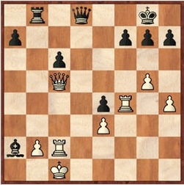
Evaluation function
Eval_{chess} =
(c₁×material) + (c₂×mobility) + (c₃×king safety) + (c₄×center control) + ...
Notes:
In graph search
Evaluation functions in Go take into account both territory controlled, influence of stones, number of prisoners and life and death of groups on the board.

Slide 29
Evaluation function
Eval_{chess} =
(c₁×material) + (c₂×mobility) + (c₃×king safety) + (c₄×center control) + ...
Eval_{public_policy} =
(c₁×GDP) + (c₂×employment) + (c₃×equality) + (c₄×environment) + ...

Slide 30
Evaluation function
Eval_{chess} =
(c₁×material) + (c₂×mobility) + (c₃×king safety) + (c₄×center control) + ...
Eval_{public_policy} =
(c₁×GDP) + (c₂×employment) + (c₃×equality) + (c₄×environment) + ...
Eval_{moral_goodness} = ?

Slide 31
Evaluation function
Eval_{chess} =
(c₁×material) + (c₂×mobility) + (c₃×king safety) + (c₄×center control) + ...
Eval_{public_policy} =
(c₁×GDP) + (c₂×employment) + (c₃×equality) + (c₄×environment) + ...
Eval_{utilitarian} = ?

Slide 33
SCOPE
(cosmic)
pan-generational
One original Picasso painting destroyed
Destruction of cultural heritage
X
existential risk
Biodiversity reduced by one species of beetle
trans-generational
Global Dark Age
Aging
Global warming by 0.01 Cº
Thinning of ozone layer
Ephemeral global tyranny
global
global catastrophic risk
local
Congestion from one extra vehicle
Recession in one country
Genocide
personal
Loss of one hair
Car is stolen
Fatal car crash
SEVERITY
imperceptible
endurable
crushing
(hellish)

Slide 34
MAXIPOK
Maximize the probability of an "OK outcome," where an OK outcome is any outcome that avoids existential catastrophe
argmax [- P(existential catastrophe / action)]

Slide 35
Evaluation function
Eval_{chess} =
(c₁×material) + (c₂×mobility) + (c₃×king safety) + (c₄×center control) + ...
Eval_{public_policy} =
(c₁×GDP) + (c₂×employment) + (c₃×equality) + (c₄×environment) + ...
Eval_{utilitarian} ≈ MAXIPOK

Slide 36
Evaluation function
Eval_{chess} =
(c₁×material) + (c₂×mobility) + (c₃×king safety) + (c₄×center control) + ...
Eval_{public_policy} =
(c₁×GDP) + (c₂×employment) + (c₃×equality) + (c₄×environment) + ...
Eval_{maxipok} = ?

Slide 37


Dynamic sustainability
TECHNOLOGY
Humanity’s current position
Dangerous regions
Once in this region, safe…
INSIGHT
COORDINATION
Notes:
Dynamic sustainability

Slide 38
Evaluation function
Eval_{chess} =
(c₁×material) + (c₂×mobility) + (c₃×king safety) + (c₄×center control) + ...
Eval_{public_policy} =
(c₁×GDP) + (c₂×employment) + (c₃×equality) + (c₄×environment) + ...
Eval_{maxipok} = f (wisdom, coordination, differential tech development, …)

Slide 39

Principle of differential technological development
Retard the development of dangerous and harmful technologies, especially ones that raise the level of existential risk; and accelerate the development of beneficial technologies, especially those that reduce the existential risks posed by nature or by other technologies.

Slide 40
Cause selection vs. signature determination
Causes should be high-leverage
Signposts should be useful for general orienteering
  we should have strong reason to think we know their directionality
  they should ideally be visible from afar

Slide 41
Some (very) tentative signposts
Computer hardware?————————————No
Whole brain emulation?———————————No(?)
Biological cognitive enhancement?——————Yes
Artificial intelligence?————————————No
Lead of AI frontrunner?-——————————---Yes
Solutions to the control problem?———————Yes
Effective altruism movement?————————-Yes
International peace and cooperation?—————Yes
Synthetic biology?-—————————————-No(?)
Nanotechnology?-—————————————--No
Economic growth?-—————————————-- ?
Small and medium-scale catastrophe prevention?-- ?
Notes:
Relative to the utilitarian supergoal
Umwertung aller Werte

Slide 42
List of some areas with candidate remaining CCs or CCCs
Counterfactual trade
Simulation stuff
Infinite paralysis
Pascalian muggings
Different kinds of aggregative ethics (total, average, negative)
Information hazards
Aliens
Baby universes
Other kinds of moral uncertainty
Other game theory stuff
Pessimistic metainduction; epistemic humility; anthropics
Insects, subroutines

Slide 43
Some partial remedies
don’t act precipitously (and in ways that are irrevocable)
invest more in analysis (find and assemble CCs)
take into account that EV-changes are probably smaller than they appear (quiescence search, meta stuff)
use parliamentary / mixture models
focus more on near term & convenient objectives (e.g. if one is partly egoist and partly altruist, but on altruism one is on a deliberation ladder, then maybe go with the egoistic part)
invest in developing inner capacity: not more powers but rather propensity to use powers better

Slide 45
Some (very) tentative signposts
Computer hardware?————————————No
Whole brain emulation?———————————No(?)
Biological cognitive enhancement?——————Yes
Artificial intelligence?————————————No
Lead of AI frontrunner?-——————————---Yes
Solutions to the control problem?———————Yes
Effective altruism movement?————————-Yes
International peace and cooperation?—————Yes
Synthetic biology?-—————————————-No(?)
Nanotechnology?-—————————————--No
Economic growth?-—————————————-- ?
Small and medium-scale catastrophe prevention?-- ?
Notes:
Relative to the utilitarian supergoal
Umwertung aller Werte

Slide 46
Technological completion conjecture
If scientific and technological development efforts do not effectively cease, then all important basic capabilities that could be obtained through some possible technology will be obtained.

Slide 47
Need for speed?
“I instinctively think go faster. Not because I think this is better for the world. Why should I care about the world when I am dead and gone? I want it to go fast, damn it! This increases the chance I have of experiencing a more technologically advanced future.”
— the blog-commenter “washbash”

Slide 48
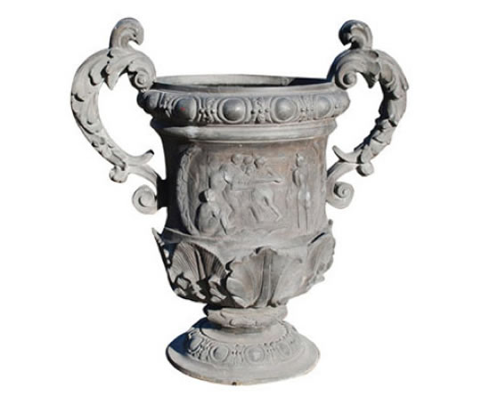




The risk of creativity

Slide 49
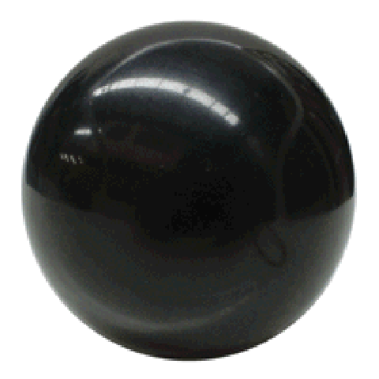
The risk of creativity
?

Slide 50
Hazardous future techs?
Machine intelligence
Synthetic biology
Molecular nanotechnology
Totalitarianism-enabling technologies
Human modification
Geoengineering
Unknown
Unknown
Unknown
Unknown

Slide 51
Past philanthropy
Share meat with the tribe?
Hold a festival for the people?
347 B.C.Plato's will left his farm to a nephew with instructions the proceeds be used to support students and faculty at the academy he founded.

Slide 52
notes
CCCs
Def deliberation ladder

